Slide 1
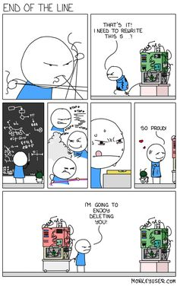
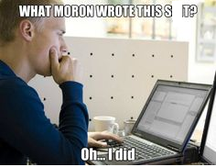
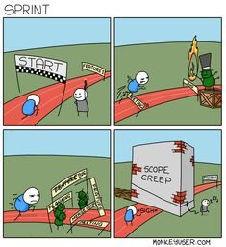
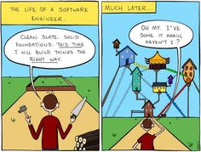
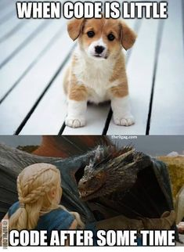
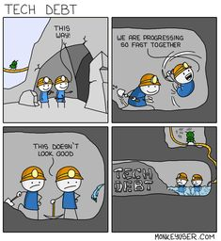
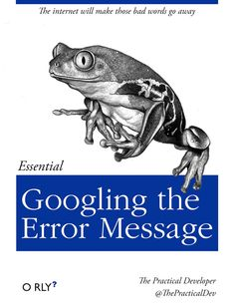
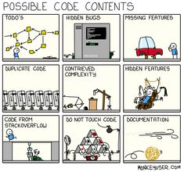
CSC 200 Lecture 12
Software Engineering
and Artificial Intelligence

Slide 2
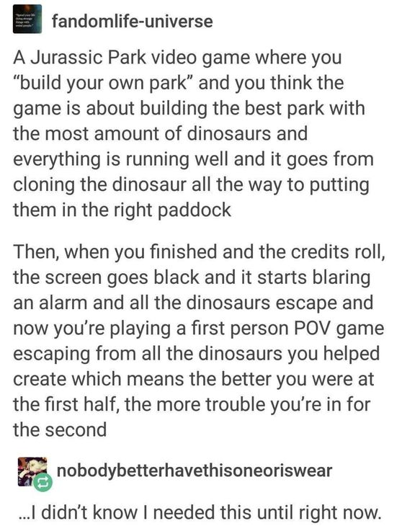
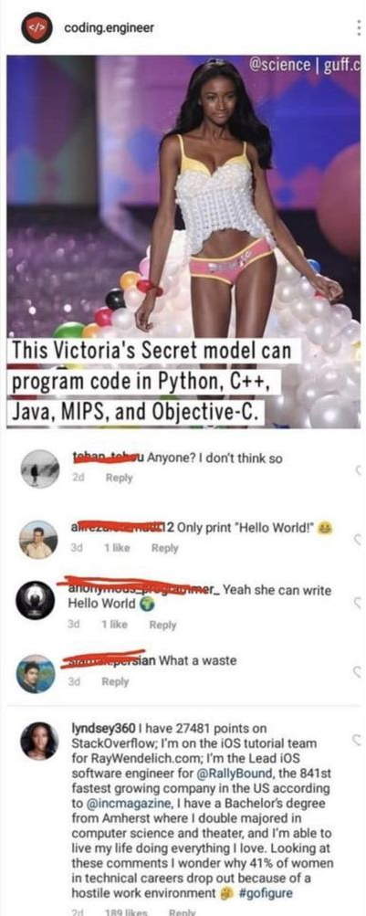
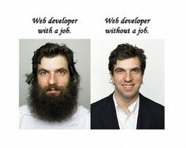
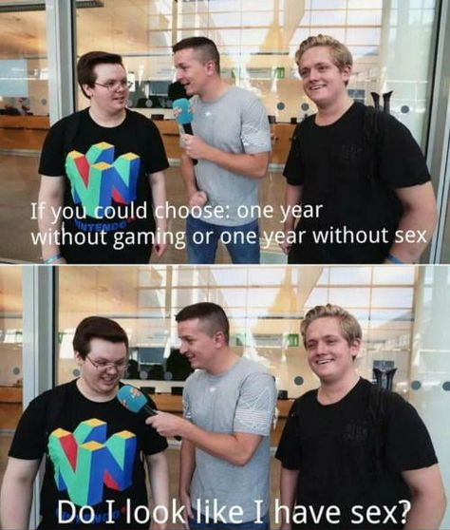

Slide 3
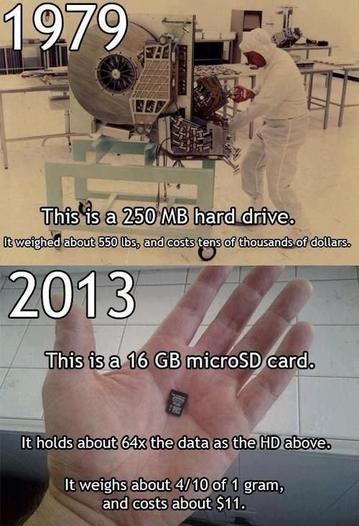
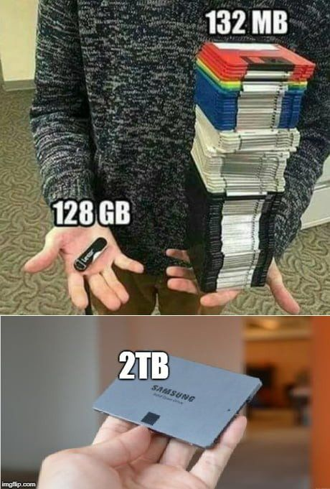

Slide 4
Software Engineering
Science – n. the exploration of unknown or partially unknown phenomena in order to extend the scope of human knowledge.
Engineering – n. the methodical application of known materials, tools, and techniques to design and implement solutions to a problem.
Software engineering – n. the application of engineering processes to the development of software.

Slide 5
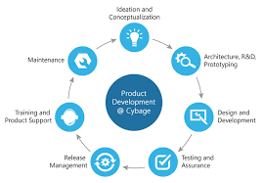
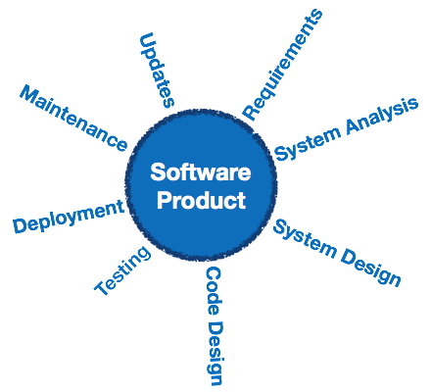
Software Engineering Models

Slide 6
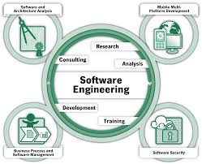
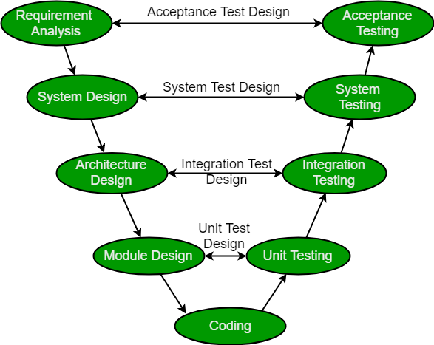
Software Engineering Models (2)
Software & Architecture Analysis
Mobile, Web, & Platform Development
Business Process & Software Management
Software Security

Slide 7
Software Engineering Models (3)
Cyclic models acknowledge that engineering is a never ending process.
Some software written in the 1960s is still in use by banks, telecommunications, and other industries.
Even the non-cyclic models are cyclic when applied iteratively.
Other models tend to reflect important related tasks.
Business (cost management, market analysis, personnel management, product scheduling)
Security (vulnerability analysis, mitigation, and tracking)
Architecture (communication channels, data format, protocols)

Slide 8
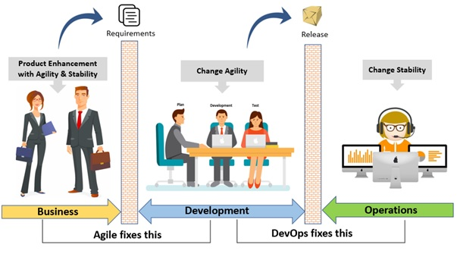
Impediments to Smooth Processes
Typically major impediments occur between:
Requirements extraction and software development.
Software development and deployment with users.
These impediments serve to segregate the software developers from the users.

Slide 9
Why Impediments
The software developers do a lot of “behind the curtain” work which we need to hide from the users.
It is equally important for developers to understand what users need and how the software is affecting their work.
No man is an island unto himself
How many software products have failed because they failed to find out and deliver what the users wanted?

Slide 10
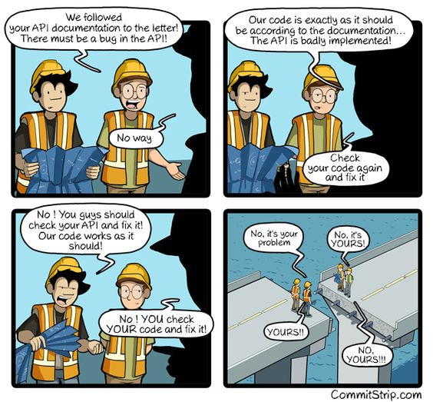
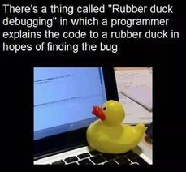
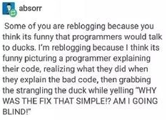

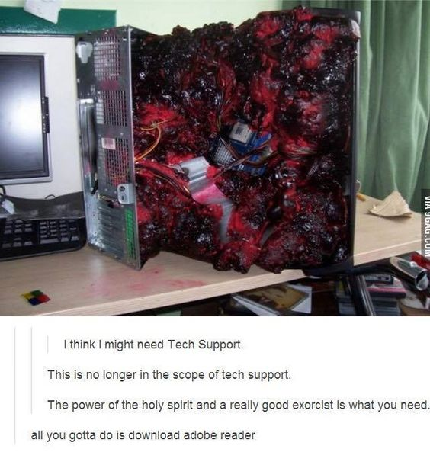

Slide 11
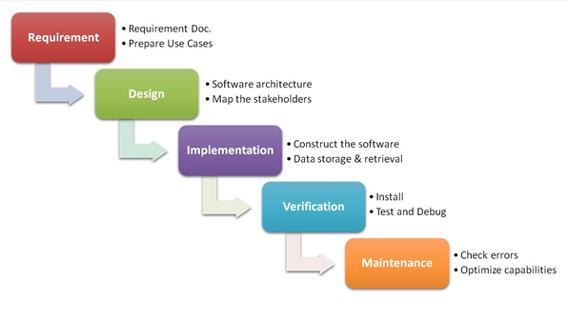
Development Paradigms
Why do these barriers exist?
Getting requirements from the user happens first.
All design and development happens next.
The software is done and packaged before the users see or use it.
You can see why these barriers exist. They are chronological.
USERS
DEVELOPERS
USERS
Waterfall – Development is characterized by fixed incremental activities. It is notoriously inflexible and prone to late deliveries and cost overruns.
This model is often taught because the software engineering tasks can be better understood as distinct steps.

Slide 12
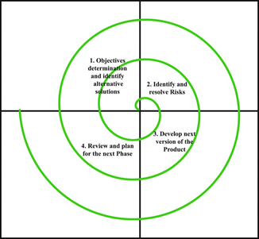
Development Paradigms (2)
Can iterations remove barriers?
In this paradigm, the developers are forced to interact with users.
You can develop, but you have to be judged.
If you get it wrong, you find out very soon.
The barriers still exist, but the developers and users are forced to repeatedly interact.
Plan first
Design
USERS
DEVELOPERS
Review
Code
Spiral – Great for building something without known requirements. Incrementally build and review a bit at a time. The size of a spiral tends to be volatile and the end of the development is hard to gauge.
https://tfetimes.com/software-development-explained-with-cars/

Slide 13
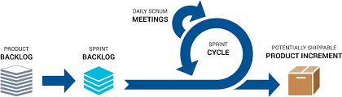
Development Paradigms (3)
Can this effect be maximized?
In this paradigm the cycles occur daily.
A sprint cycle may last a few weeks.
Daily meetings review plan, progress, and problems.
User representatives have a say in how things are going.
Critically, a version of the finished product goes out the door every few weeks.
Agile – Focuses on throughput of requirements i.e. features go to the user. The plan can change every few weeks, but while the developers are working, they can’t be harassed. ☺ Even so, developers are held accountable for progress or lack of it.

Slide 14
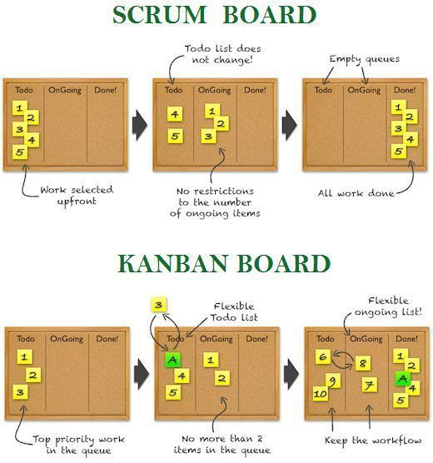

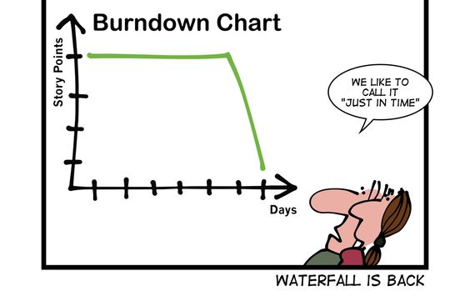

Slide 15
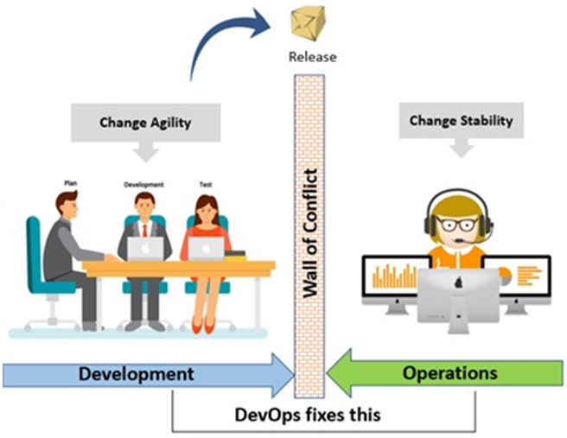
More Barriers?
Dev(elopment) is the environment and process where the software is written.
Op(eration)s is the environment where the software runs for the customer.
Are you building something which can quickly and securely be deployed to the users?
https://www.accenture.com/us-en/blogs/blogs-reshma-shinde-devops-transformations-operations

Slide 16
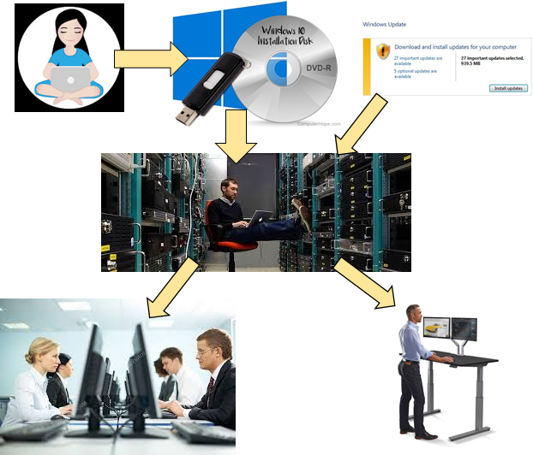
Deployment
Developers are prone to think of deployment as installation on one computer.
The system admin has to install on servers, cube-farm computers, and distant offices.
Other concerns:
Security updates
Personal preferences/data
New hardware
OS updates
System admins are busy.

Slide 17
Conflicting Goals
Dev wants to get the next feature/fix out the door ASAP.
Ops wants nothing to change so the system stay stable.
Each change from Dev takes a lot of effort from Ops to deploy.
The deployment schedule from Ops enforces longer deployment intervals on Dev.
https://www.accenture.com/us-en/blogs/blogs-reshma-shinde-devops-transformations-operations

Slide 18
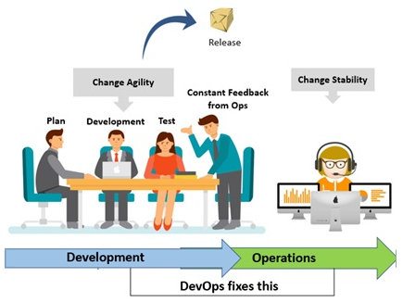
DevOps
DevOps creates an integrated team.
Their goal is to create a build which is automatically integrated into the operational environment.
Technology helps meet this goal.
VMs make hardware/OS updates easier.
Containers make application/OS updates easier.
Shared knowledge between Dev and Ops.
Metrics from Ops can improve Dev.
Sys Admins become more aligned with development. More scripts. More automation. Fewer manual processes.
https://www.accenture.com/us-en/blogs/blogs-reshma-shinde-devops-transformations-operations

Slide 19
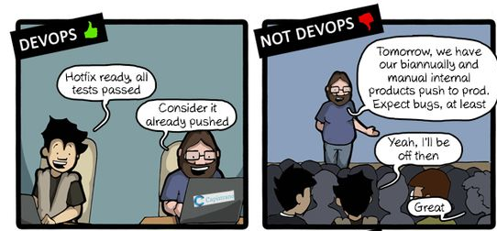
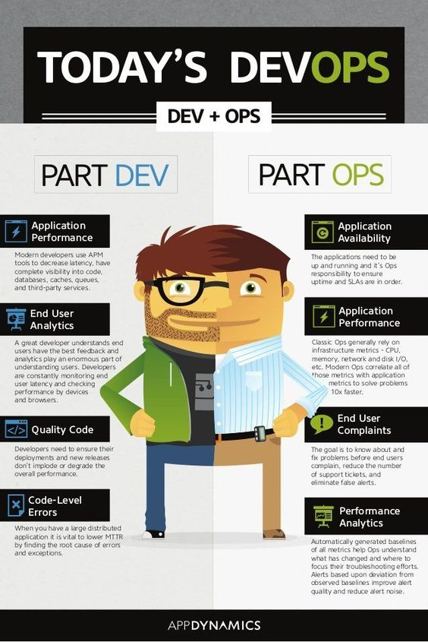
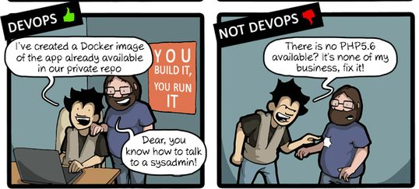

Slide 20
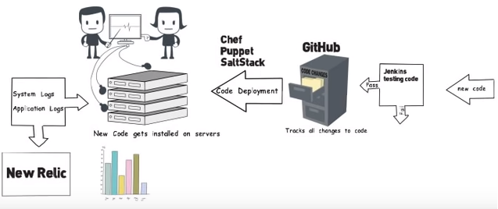
Tools Everywhere
Tools become increasingly important in DevOps.
Faster pace; no bottlenecks
Larger scale; massive data
Strategic thinking
Tools in each of these several areas become critical to maintaining an acceptable tempo.
Building code
Managing configuration
Testing
Building application
Deployment
Monitoring systems
Reporting
https://www.youtube.com/watch?v=_I94-tJlovg

Slide 21
For the Exam / Homework
Know and describe the software engineering process.
Requirements analysis
Design
Implementation
Test
Explain why software engineering is a cyclic process.
Know the pros and cons of waterfall, spiral, and agile development paradigms.
Describe the concepts of DevOps.

Slide 22


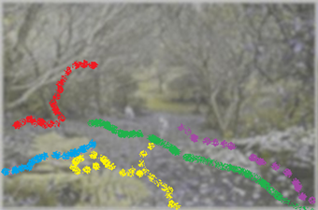
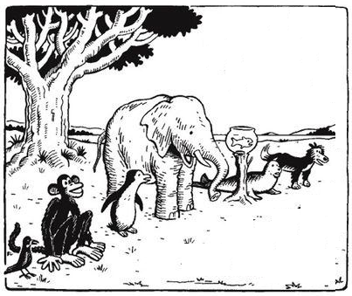
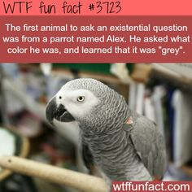
What is Intelligence?
Defining intelligence is hard.
Are humans even a good standard?
Do we count human mistakes?
What other standard could we use?
How do we compare intelligences?
Do senses make a difference?
What is a fair test?
Climb a tree?
Swim a mile?
Lift a tree?
Catch a fly?

Slide 23
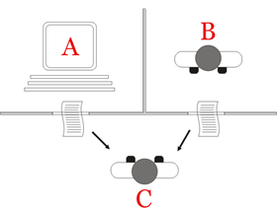
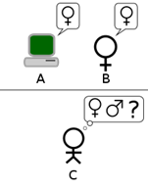
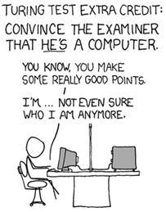
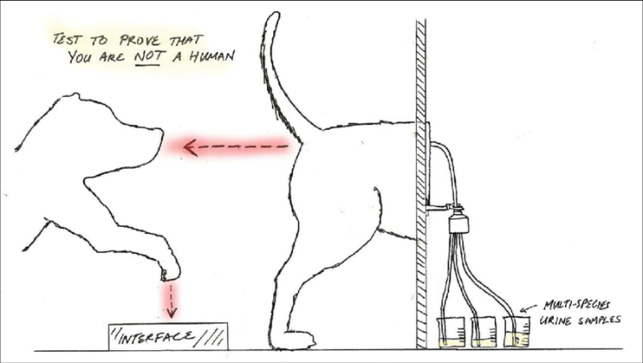
How Intelligent is a Computer?
The Turing test is the gold standard for artificial intelligence.
No one has passed this test to date.
The test has also been adapted in several variations which it has passed.
How long can you fool a human?
Can you fool a human within a limited subject matter?
Can humans reverse the test?

Slide 24
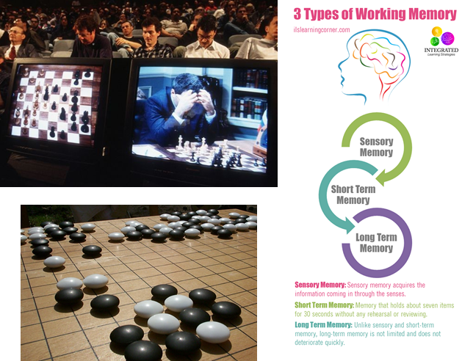
How Much Can It Remember?
Memory seems to be a key element in intelligence.
With no memory you can only react to the current moment
With some memory you may improve your performance.
A mental concept of the world allows you to plan for long-range objectives.
At what point does the intelligence recognize that it exists as an entity.
https://learn.g2crowd.com/types-of-artificial-intelligence

Slide 25
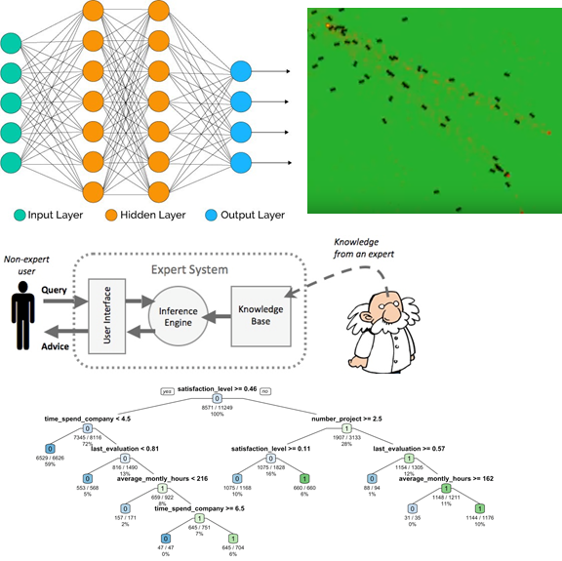
Types of AI
Popular forms of AI:
Neural networks replication human neurons taking multiple inputs and delivering multiple outputs. They learn to create the right output based on training data. Is it a bird?
Automata/Agents have individually limited capabilities, but work together to accomplish greater things (e.g. like ants). Where is the metal weakest?
Expert systems take a great deal of knowledge and can infer the most likely answer based on limited input. What ails my patient?
Decision trees depend on probabilities and known values to predict the best option. Should I buy/sell this stock?
https://futurism.com/images/types-of-ai-from-reactive-to-self-aware-infographic

Slide 26


Learning
Inputs = {I₁, I₂, I₃, … I_{n}}
All learning AIs work in much the same way.
Provide the AI with a range of inputs.
Provide a set of training data conforming to that input
See what the AI finds.
AI-written algorithms are not necessarily “intelligent”.
Nor can they always be understood.
Training set = { {I₁, I₂, I₃, … I_{n}}₁ ,
{I₁, I₂, I₃, … I_{n}}₂ ,
{I₁, I₂, I₃, … I_{n}}₃ ,
…
{I₁, I₂, I₃, … I_{n}}_{k} }
Conclusion: Cats get wet when it rains.
Conclusion: Eating out on a Wednesday
decreases life expectancy by 20 years.
“At some point [the AI’s] programmers didn’t understand
why [the AI] was doing what it was doing.”

Slide 27
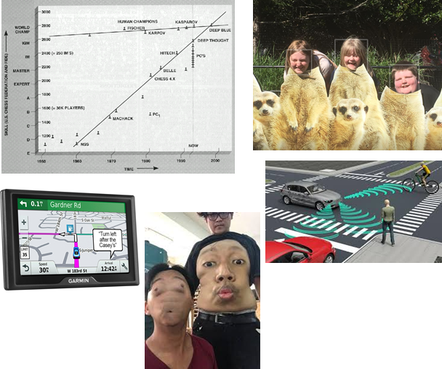
Current State of AI?
Computers finally beat humans at chess in the 1990’s.
Computers are increasing better and identifying faces.
There are some mistakes.
Self driving cars are a ways off
Driving aides (same lane, parking, etc.) already exist.
Computers can already map the world.
Given an update, they are very accurate.

Slide 28
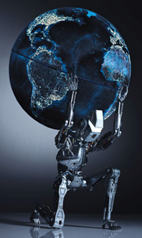
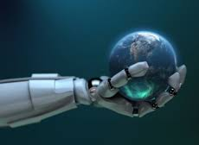
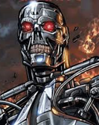
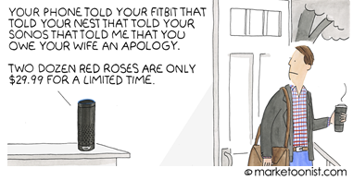
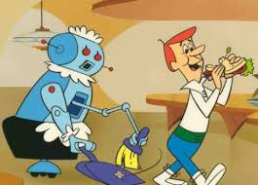

Future of AI
Already we are using robotics and AI for many things.
Tracking appointments
Gathering data
Coordinating needs
At some point they will either be:
Our servants
Our equals
Our enemies
Right now the trend is for robots to form a new slave class.
Will they become any class of citizen?
Will we have civil rights for AI’s?
Will we debate reparations for AI’s?

Slide 29
For the Exam / Homework
Given an example of behavior, give reasons why it is/isn’t intelligent.
Explain the Turing test. Possibly take it in a limited scope.
List the AI’s which you use on a daily basis.
Define the senses, memory, capabilities, and limitations of an AI such as a DVR.

